Slide 1
CalPERS Update & Discussion
David Teykaerts | Stakeholder Strategy Manager
Kurt Schneider | Supervising Pension Actuary
October 10, 2019

Slide 2
Fundamental Concepts and Investments

Slide 3


CalPERS Membership
38%
School members
1.9 million
members
31%
Public Agency members
31%
State members

Slide 4
Functions In Pension Decision-Making
CalPERS Board
Fiduciary obligation
Set risk tolerance
Set investment asset allocation
Legislature
Set menu of pension benefit formulas
Make and change pension laws
Benefit design changes
Employees
Make contributions
Select employer
Collectively bargain salary and (optional) cost sharing
CalPERS Staff
Administer pensions
Calculate pension costs
Effectuate investment strategy
Employers
Select pension formulas
Add optional provisions
Set salaries
Make contributions
Courts
Rule on legal questions of pension law

Slide 5
CalPERS Recent & Historical Investment Performance
Current Fund Value $380 billion~
6.7%
8.1%
5.6%
6.1%
8.4%
2018/19
5-yr Annualized
Return
10-yr Annualized
Return
20-yr Annualized
Return
30-yr Annualized Return
Notes:
It is important to understand how CalPERS Retirement Benefits are funded. Every dollar spent on public employee pensions comes from three sources:
Investment earnings at 61 cents for every dollar, or 62 percent
Contributions from CalPERS Employers at 26 cents for every dollar, or 25 percent
Contributions from employees at 13 cents for every dollar, or 13 percent
Common sense tells us that this cannot fall below the dollar, or 100% - so if one of the sources, such as investment, shifts downward, then the other sources will shift up.
It is important to know that CalPERS serves as the manager of the Fund. We do not have an alternate budget or source to pull from to fund pensions or make up the pension dollar. We also don’t determine the benefits – we administer the benefits negotiated by our employers and beneficiaries.
The money that we manage does not belong to us – it belongs to our members and we have fiduciary responsibility to make sure it is there when they are ready to retire from public service. This is why it is important for us to make strategic long-term investments to sustain the Fund.

Slide 6
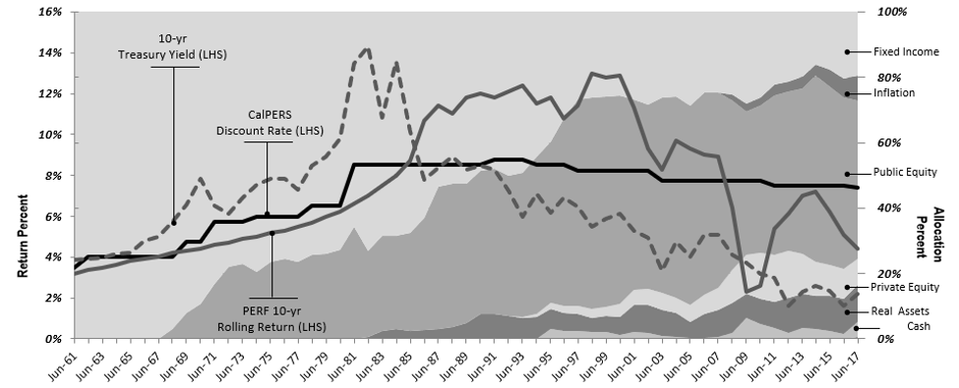

Slide 7
Three Key Risks
  Investment
  risk/liquidity
  Climate risk
  to the portfolio
  Employer
  Affordability

Slide 8
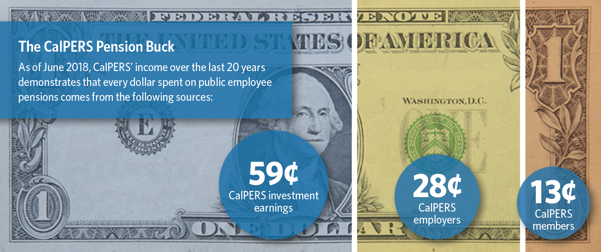
How are CalPERS Pensions Funded?

Slide 9
71%
Funded status goal: 100%
50-60%
70-80%
90-100%
Notes:
Slide 7
Strong Progress but Challenges Ahead
Funded Status and What It Means
Estimated 71% - on our way
Goal is 80% and 90 %
50% hard to come back from

Slide 10
Divestment | Corporate Engagement

Slide 11
CalPERS Focus Going Forward
Investment performance is paramount
  growth assets are key
Top quality leadership and investment team
Streamlined investment strategies
Capitalize on and weather financial market downturns
Recognize that employers are essential to sustaining benefits
One message to all stakeholders
Provide access and information
Notes:
It is important to understand how CalPERS Retirement Benefits are funded. Every dollar spent on public employee pensions comes from three sources:
Investment earnings at 61 cents for every dollar, or 62 percent
Contributions from CalPERS Employers at 26 cents for every dollar, or 25 percent
Contributions from employees at 13 cents for every dollar, or 13 percent
Common sense tells us that this cannot fall below the dollar, or 100% - so if one of the sources, such as investment, shifts downward, then the other sources will shift up.
It is important to know that CalPERS serves as the manager of the Fund. We do not have an alternate budget or source to pull from to fund pensions or make up the pension dollar. We also don’t determine the benefits – we administer the benefits negotiated by our employers and beneficiaries.
The money that we manage does not belong to us – it belongs to our members and we have fiduciary responsibility to make sure it is there when they are ready to retire from public service. This is why it is important for us to make strategic long-term investments to sustain the Fund.

Slide 12
Actuarial Concepts and the City’s Pension Costs

Slide 13
Contribution Components
Normal Cost
(% of Payroll)
UAL Amortization Payment
($ Amount)
Total Contribution

Slide 14
Unfunded Accrued Liability (UAL)
UAL
Accrued Liability
Market Value
of Assets
=
–

Slide 15
Required Contribution is the Minimum Payment
Agencies are required to make minimum annual payments on the UAL
Unfunded accrued liability is long-term debt
Interest rate charged on UAL = Discount rate

Slide 16
Principles of Paying Down Debt
Basic Financial Principle – pay down most costly debt first
Government Finance Officers Association (GFOA)
  Every agency should have a funding policy
  Provide assurance that benefits will be funded equitably and sustainably
  Handle UAL paydown in a systematic way

Slide 17
Options for Accelerating the Funding of a Plan
Ad Hoc
Additional Discretionary Payments (ADPs)
Fresh Start
Full or partial
IRS Section 115
Trusts

Slide 18
Additional Discretionary Payments (ADPs)
Saves money by reducing future interest payments
Ad hoc basis
Savings strategies
  Short-term Savings : apply to shortest base
  Long-term Savings : apply to longest base
Can be used to achieve contribution stability
If used in conjunction with agency’s funding policy ADPs can
  Handle UAL paydown in a systematic way, and
  Provide assurance that benefits will be funded equitably and sustainably

Slide 19
ADPs in Practice

Slide 20
ADPs in Practice (continued)
Woodland – May 2018
Lodi – July 2018 and July 2019
Rocklin – 2016, 2017, 2018 and 2019
Yuba City – September 2018

Slide 21
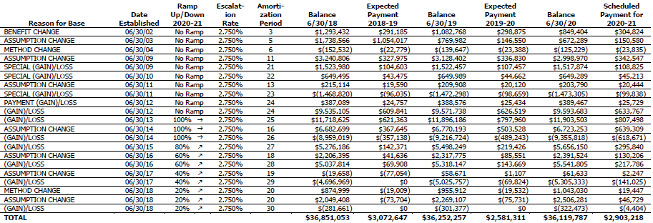
Schedule of Amortization Bases

Slide 22
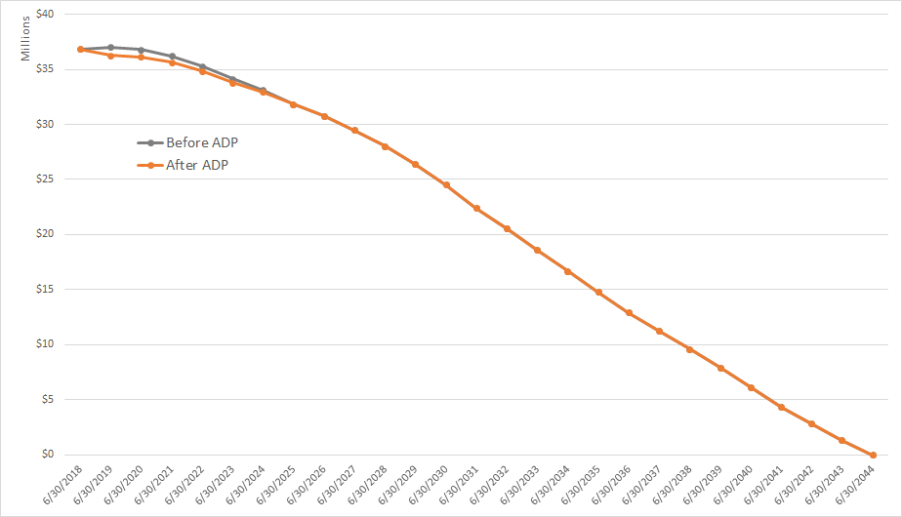
Miscellaneous UAL Balance before and after 2018 ADP

Slide 23
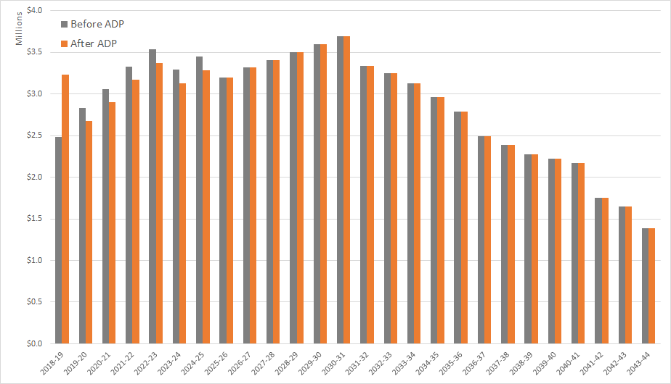
Miscellaneous UAL Annual Payments before and after ADP

Slide 24
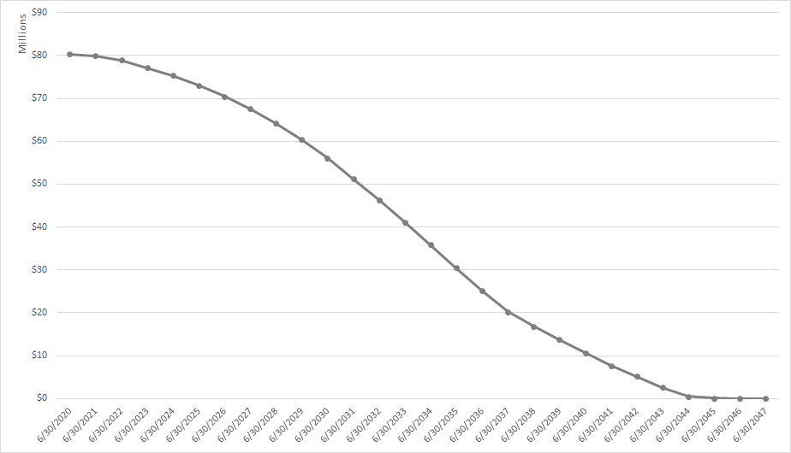
Combined Yuba City Projected UAL Balance

Slide 25
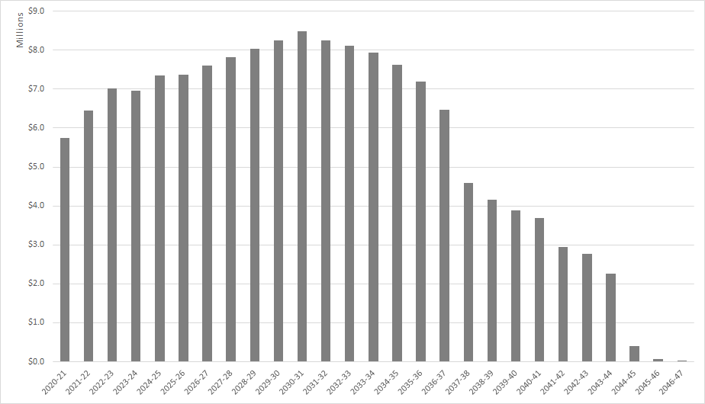
Combined Yuba City Projected UAL Payments

Slide 26
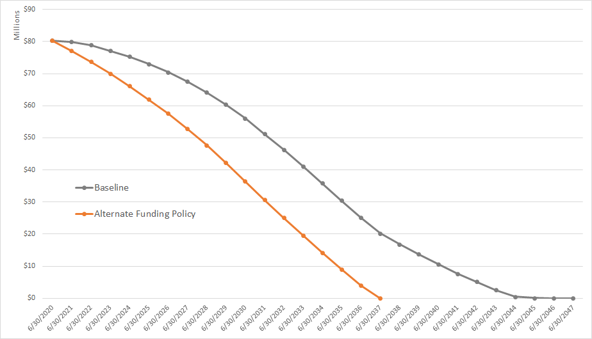
Alternate Yuba City Projected UAL Balance

Slide 27
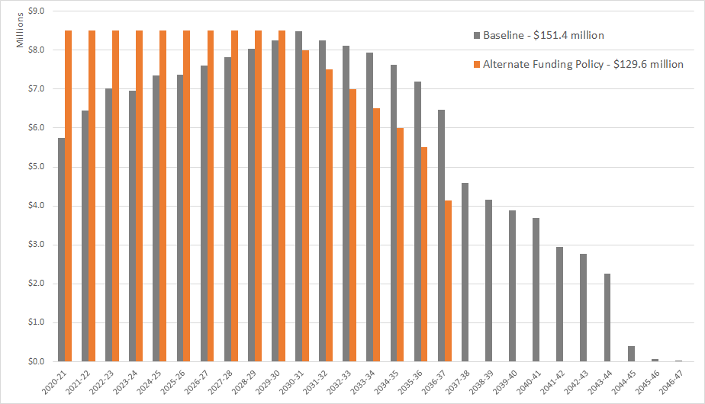
Alternate Yuba City Projected UAL Payments

Slide 28
Alternate Funding Policies
  ADPs allow maximum flexibility
  Agency can budget for any payment structure
    Level annual payments
    Gradually increasing payments
    Gradually decreasing payments
  Agency can target full funding date

Slide 29
Advantages to Establishing a Funding Policy
  Provides assurance that benefits will be funded equitably and sustainably
  Handles UAL paydown in a systematic way
  Allows agency to budget contributions years in advance
  Actuarial experience or assumption changes less likely to trigger contribution increases
  Significant savings are possible

